Slide 1
C Sharp
Language in a Brief .

Slide 2
C sharp introduction : -
C sharp is generally object – oriented language .
It was developed by Microsoft led by Anders Hejlsberg and his team within the .Net initiative and was approved by the European Computer Manufacturers Association (ECMA) and International Standards Organization (ISO).
C# is a lot similar to Java syntactically and is easy for the users who have knowledge of C, C++ or Java. And c# is a common language of infrastructure and current the version of c# is 7.2.
A bit about the .net framework : -
.Net applications are multi-platform applications and framework can be used from languages like C++, C#, Visual Basic etc. It is designed in a manner so that other languages can use it.

Slide 3
C sharp use : -
C# (pronounced "See Sharp") is a modern, object-oriented, and type-safe programming language.
C# enables developers to build many types of secure and robust applications that run in . NET.
C# has its roots in the C family of languages and will be immediately familiar to C, C++, Java, and JavaScript programmers.
in the visual studio software are use in many language so that link for download https://visualstudio.microsoft.com/downloads .
First we will start the simple program of c # .
C# simple hello world syntax : -

Slide 4
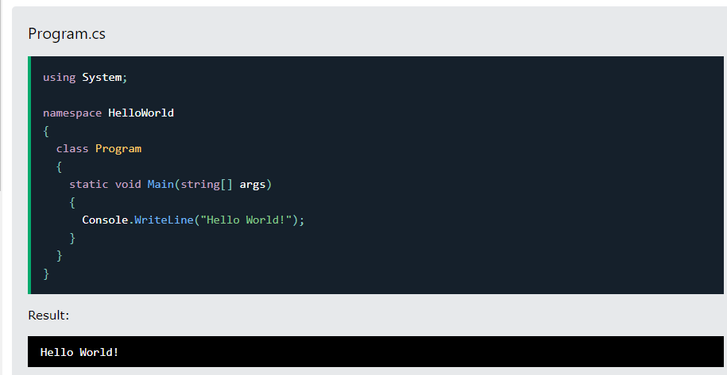

Slide 5
using system means that we can use the classes from the system namespace.
namespace is used to organize your code and it is a container for classes and other namespaces.
The curly braces {} marks the beginning and the end of a block of code.
class is a container for data and methods, which brings functionality to your program.
Main is a method there are the curly braces {} we can executed the code and we can the write the code in curly braces .in c# the complier was a line to line compling the code and executed .
Console is the class of the system namespaces ,which has a WriteLine() method is used to output /print the line .
Every C# statement ends with a semicolon ; .
C# is case-sensitive: "MyClass" and "myclass" has different meaning.

Slide 6
C # comments:-
Single-line comments start with two forward slashes (//).
Single-line comments start with two forward slashes (//).
Comments can be used to explain C# code, and to make it more readable. It can also be used to prevent execution when testing alternative code.
There are two types comments :-
Single-line comments:-
Multi-line comments:-
Single-line comments:-
Single-line comments start with two forward slashes (//).
Any text between // and end of line is ingnore by the c# (will not executed text).
Simple example of single-line comments:-

Slide 7
syntax:-
using system ;
namespace hello
{
Class helloworld
{
Static void main(string [] args)
{
//this is a single line comments.
Console.writeLine(“Hello I am comments.”);
}
}
}

Slide 8
2. Multi-line comments :-
Multi-line is start with “/*” and end with “*/”.
Any text between “/*” and “*/” is ignore by c#.
multi- line syntax :-
using System;
namespace HelloWorld
{
class Program
{
static void Main(string[] args)
{
/* The code below will print the words Hello World
to the screen, and it is amazing */
Console.WriteLine("Hello World!");
}
}
}

Slide 9
C # variable :-
Variables are containers for storing data values.
In C#, there are different types of variables (defined with different keywords), for example:-
int :- intenger store the integer number without decimal just like example 1234455…
double :- stores floating point numbers, with decimals, such as 19.99
Char :- store single characters ,such as ‘a’ or ’s’.characters value surrounded in single quotes .
string :- store the text ,such as “hello world”.string value surrounded in double quotes .
bool :- store value with two states: true or false .
Declaring (create)variables just like syntax :-
type variablename =value;
Example :-
string name =“tiger”;
Console.WriteLine(name);

Slide 10
other types:-
int mynum=23;
doble mybool=34.66D;
char myletter=‘r’;
bool my=true;
string mytext=“Shivangi”;

Slide 11
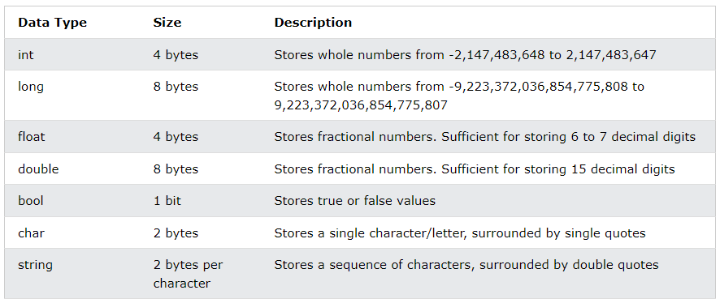
C # data types :-

Slide 12
C # type casting :-
types casting is when you assign the value in one data to another types .
In c # , there are two types in type casting :-
1. implicit casting (automatically):-
char-> int->long->float->double
2. Explicit casting (manually):-
double->float->long->int->char

Slide 13
Implicit casting syntax :-
int myint=6;
int myInt = 9;
double myDouble = myInt; // Automatic casting: int to double
Console.WriteLine(myInt);
Console.WriteLine(myDouble);
output:-
9
9
Explicit casting syntax :-
double myDouble = 9.78;
int myInt = (int) myDouble; // Manual casting: double to int
Console.WriteLine(myDouble);
Console.WriteLine(myInt);

